Slide 1
Tower Defense Design
Document

Slide 2
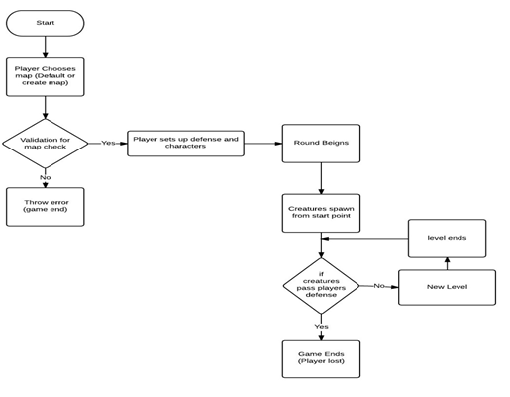
Summary

Slide 3
Abstract of Game Story
Tower defense is a subgenre of real time strategy game. The goal of tower defense games is to try to stop enemies from crossing a map by building traps to slow them down and towers which shoot at them as they pass. Enemies and towers usually have varied abilities, costs, and upgrade prices. When an enemy is defeated, the player earns money or points, which are used to buy or upgrade towers, or upgrade the number of money or points that are earned, or even upgrade the rate at which they upgrade.
The choice and positioning of the personal towers is the essential strategy of the game. It features enemies that run through a "maze", which allows the player to strategically place towers for optimal

Slide 4
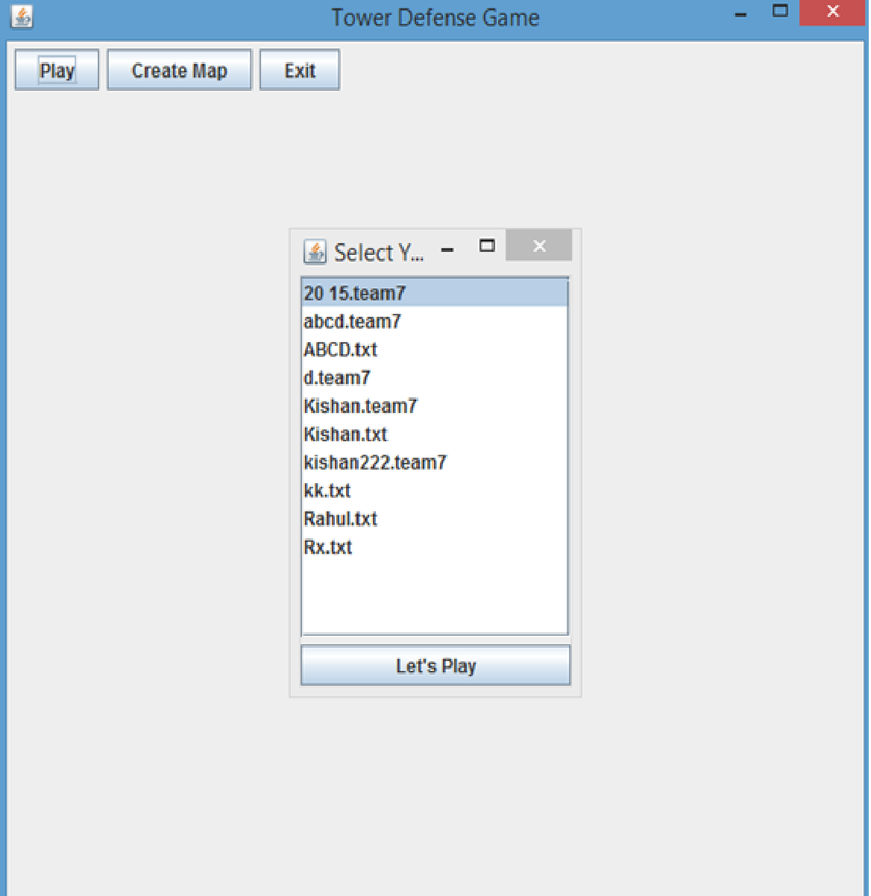
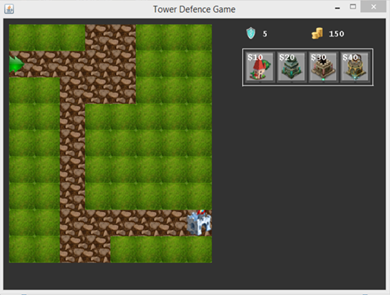
Game Play Look And Feel

Slide 5
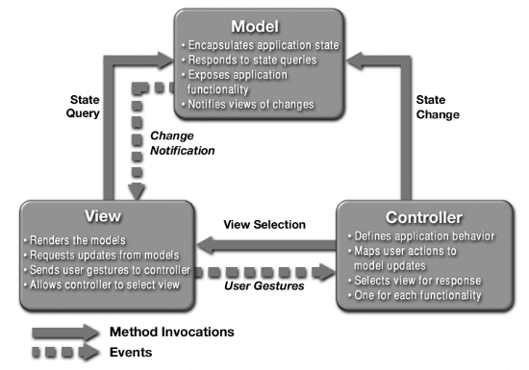
INCORPORATING MVC

Slide 6
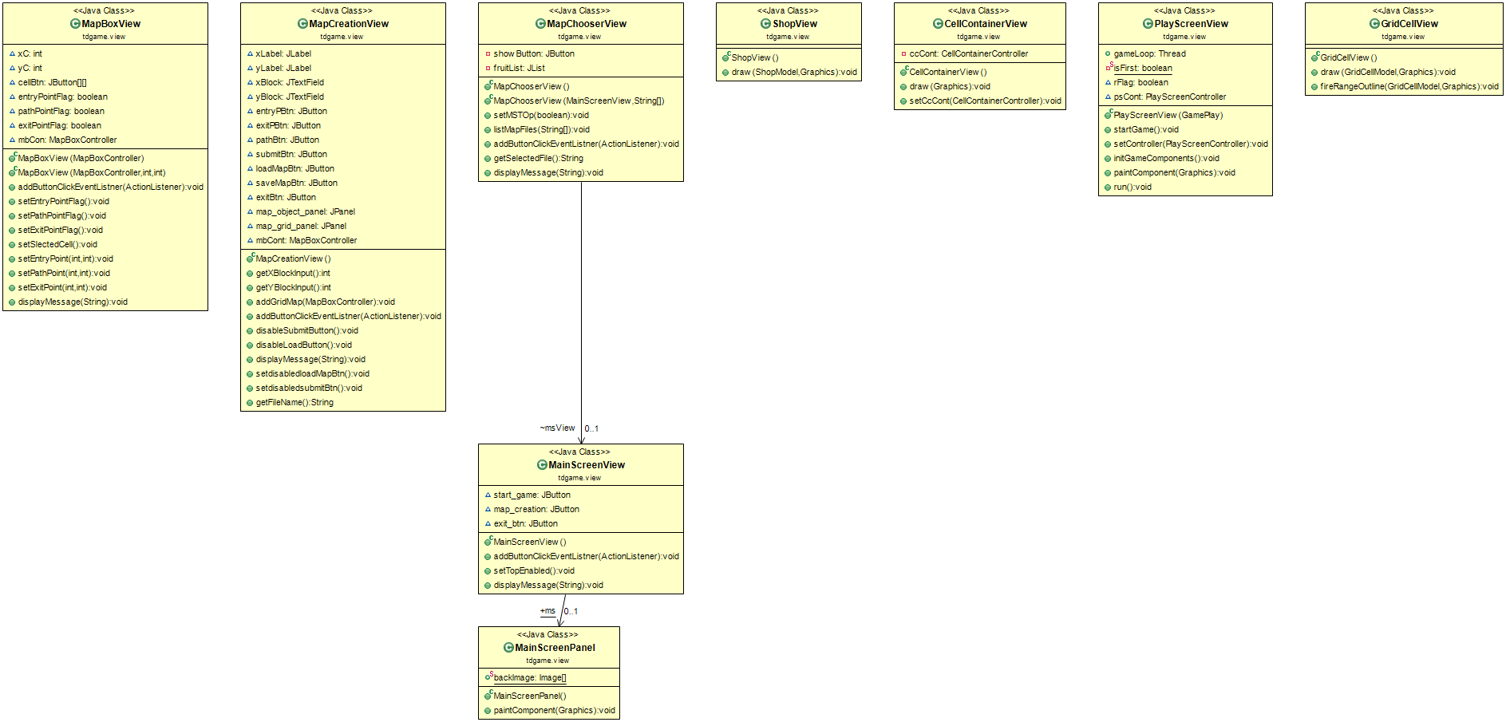
MODEL

Slide 7
VIEW

Slide 8
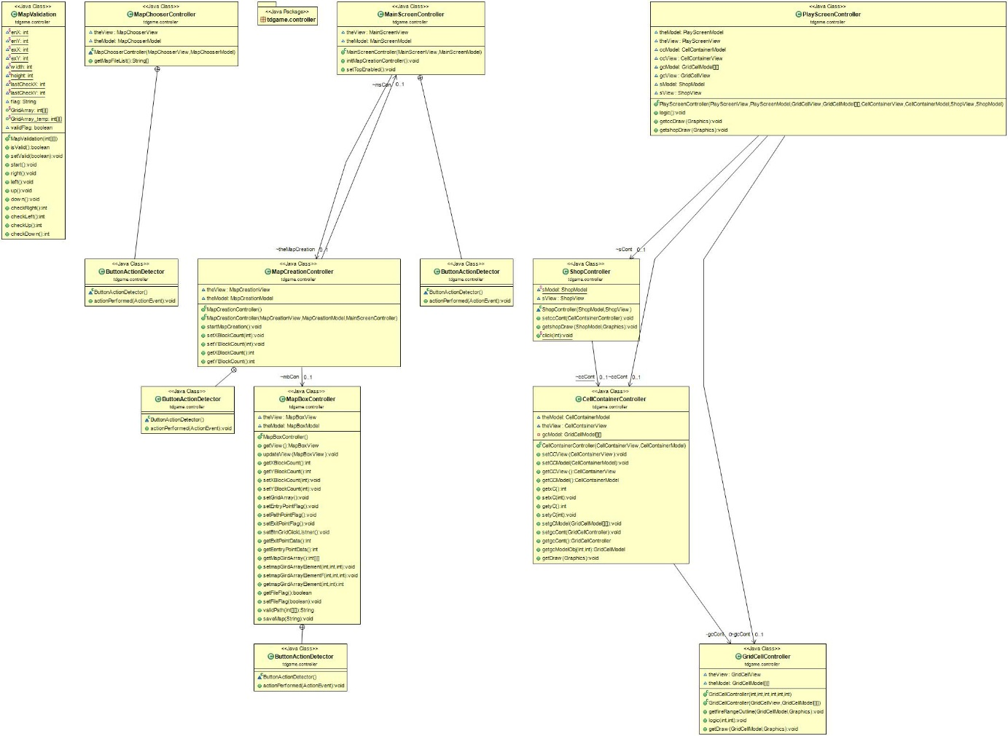
CONTROLLER

Slide 9
Player Roles and Actions
It is the players role to place turrets in such a way that enemy units are destroyed before they can cross to the end of the map
Clicking on an empty square will place a turret if funds allow
Clicking on a turret gives the player the option to upgrade or sell the turret
  Upgrading the turret will change the appearance and damage of the turret
  Selling the turret will refund the player a fraction of the turrets worth

Slide 10
Strategies and Motivations
The player is given a limited amount of resources
For each turret placed the player loses resources
For each enemy unit destroyed the player gains resources

Slide 11
Level Summary/Story Progression
Enemies spawn as waves
If the player can stop all the waves on a map and still has health remaining, the player proceeds to the next map
If the player can finish all maps, the player wins the game

Slide 12
THE END

